Slide 1

Student record system
N.B.K.R.I.S.T
VIDYANAGAR
AUTONOMUS
Student record system
PRESENTED BY
k.Venkata sudheer (24KB1A05p9)​
K.Rohan balaji(24KB1A05t3)​
k.Guru raja(24KB1A05w3)​
k.manindra (24KB1A05w2)​
​
UNDER GUIDENCE
p.suneetha

Slide 2
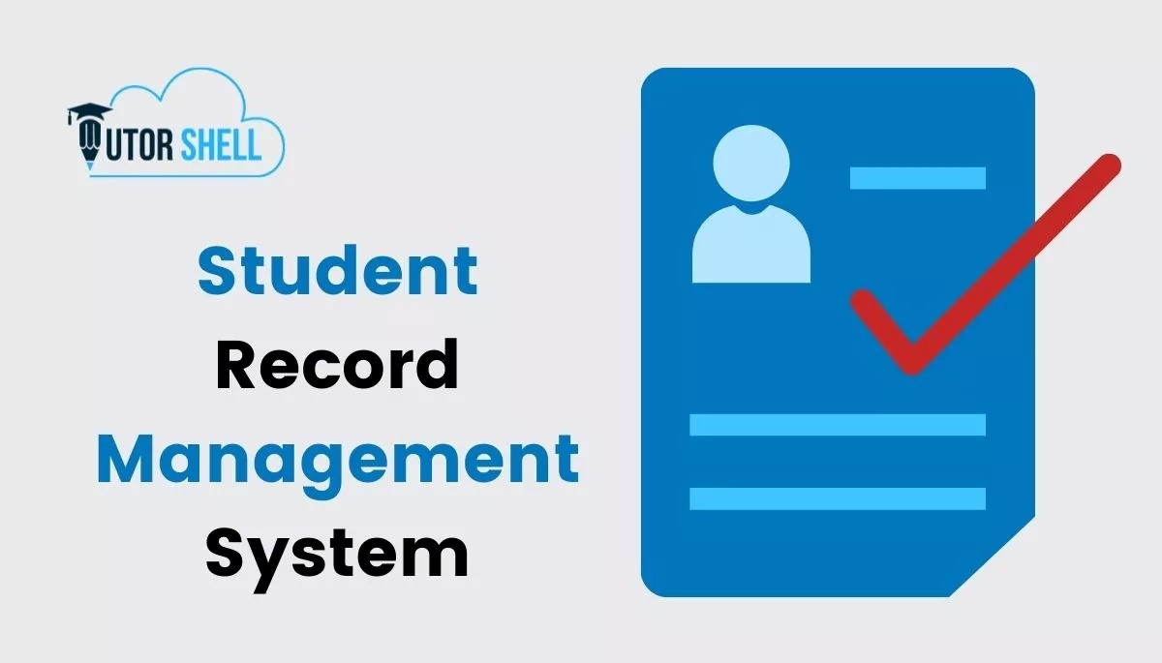

Slide 3
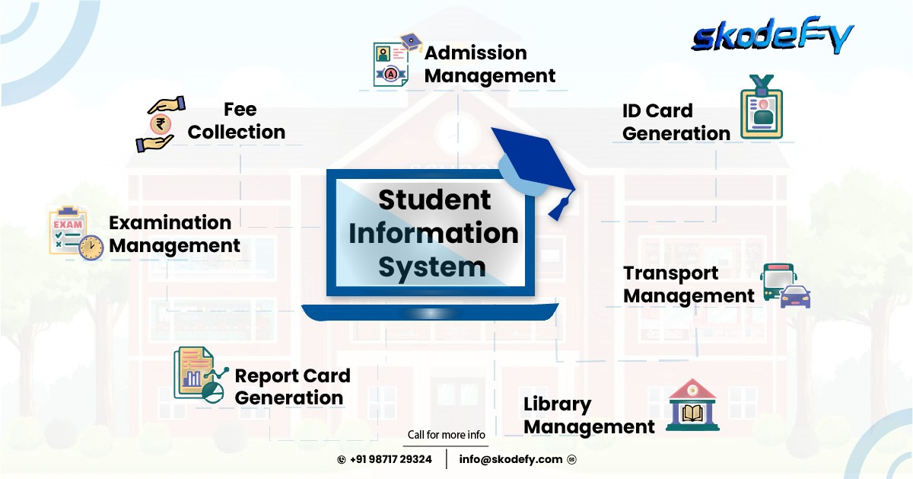

Slide 4
OBJECTIVE
Introduction - The Need for a Student Record System
Title: The Challenges of Traditional Record Keeping
Points:
. Time-consuming manual processes.
. Risk of errors and data loss.
. Difficulty in accessing and sharing information.
. Lack of centralized data for analysis.
. Increased administrative burden.

Slide 5
OBJECTIVE
What is a Student Record System?
Title: Streamlining Information Management
Points:
A centralized digital platform for managing all student-related data.
Automates administrative tasks, improving efficiency.
Provides secure storage and easy access to information.
Facilitates better communication and decision-making.
Key Features of a Student Record System
Title: Core Functionalities
Points:
Student Information Management:
Personal details (name, address, contact info)
Enrollment details (admission date, program, batch)

Slide 6
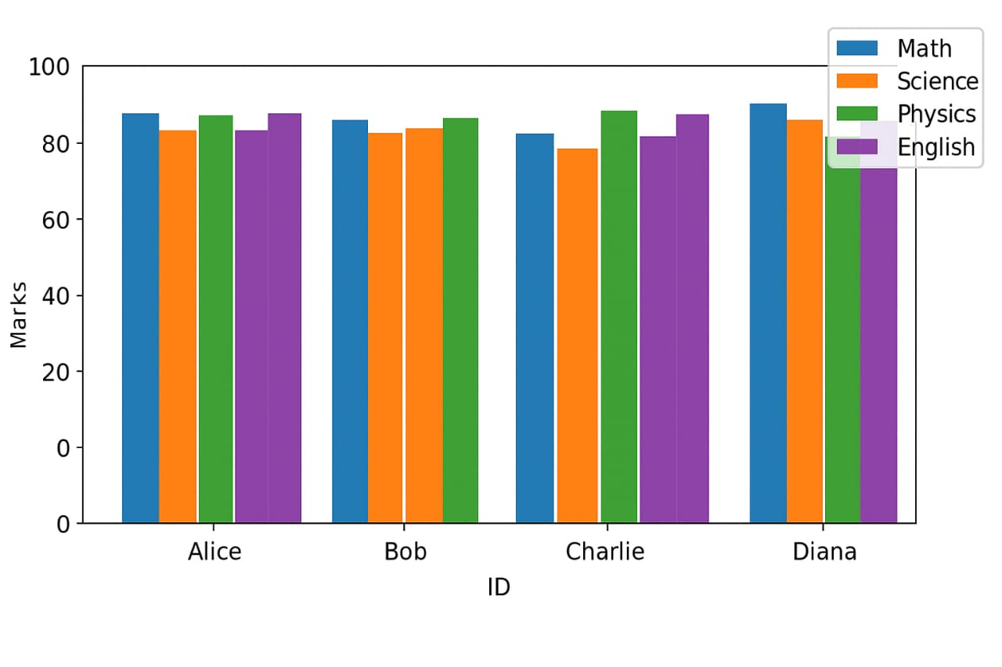
A Queue Data Structure is a fundamental concept in computer science used for storing and managing data in a specific order.
GRAPH

Slide 7
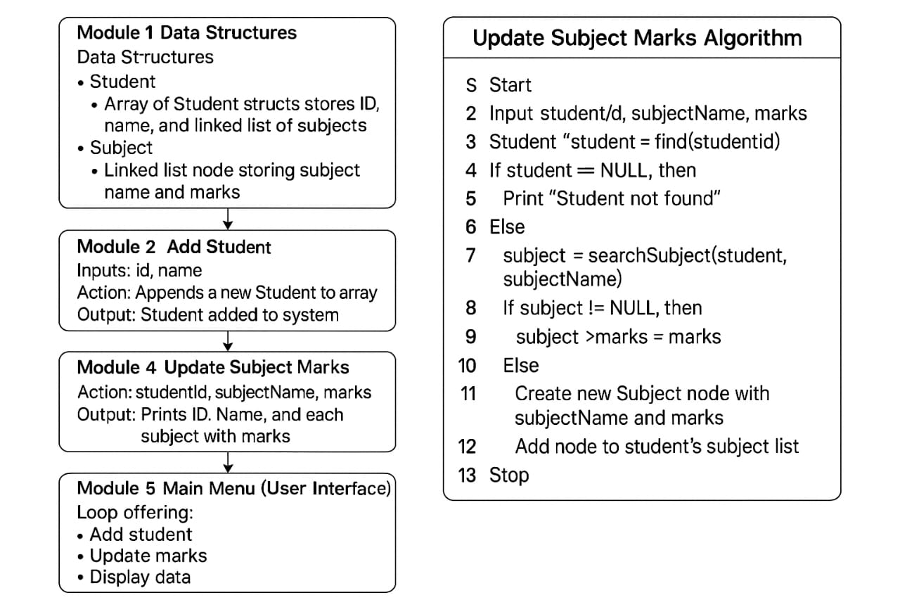
ALGORITHEM

Slide 8
SOURCE LINK
link: https://github.com/maheshchallagiri/sbi-banking-application-using-queue/blob/main/deepseek_c_20250502_5cbebd.c#L11

Slide 9


